Slide 1
Aristo: Allen
AI Challenge
Jeroen Craps
Jorik De Waen

Slide 2
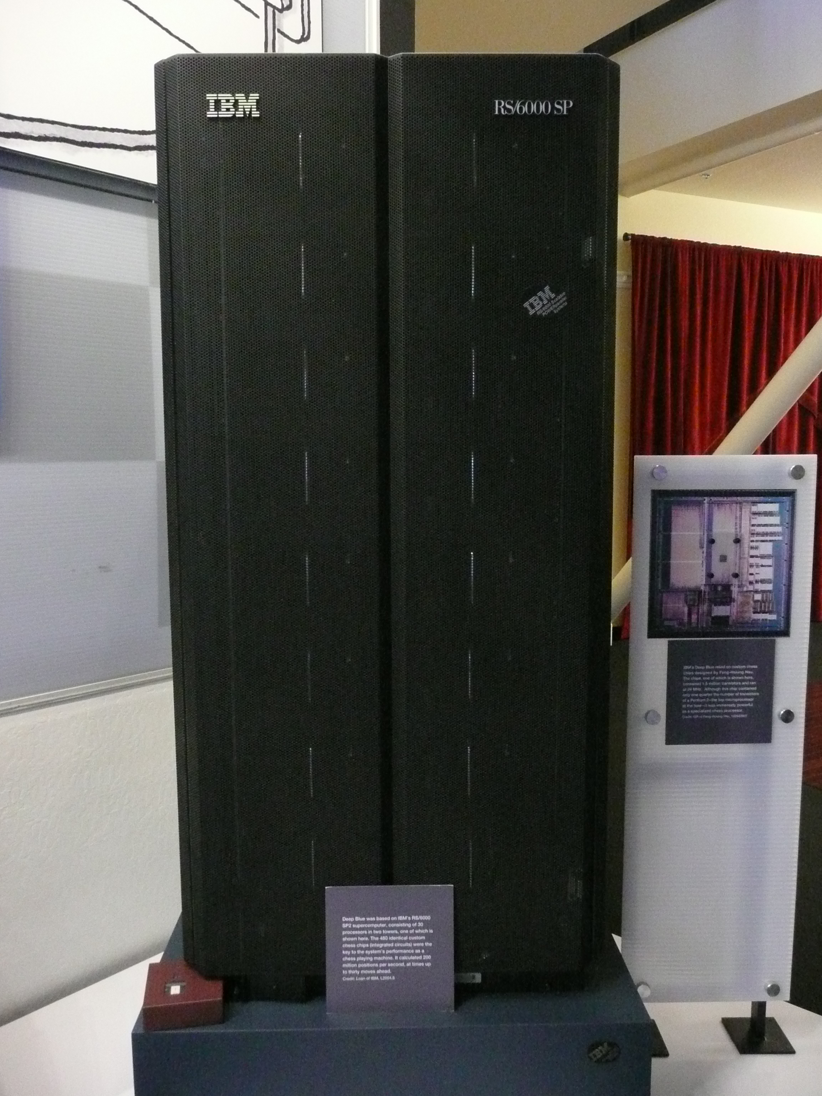
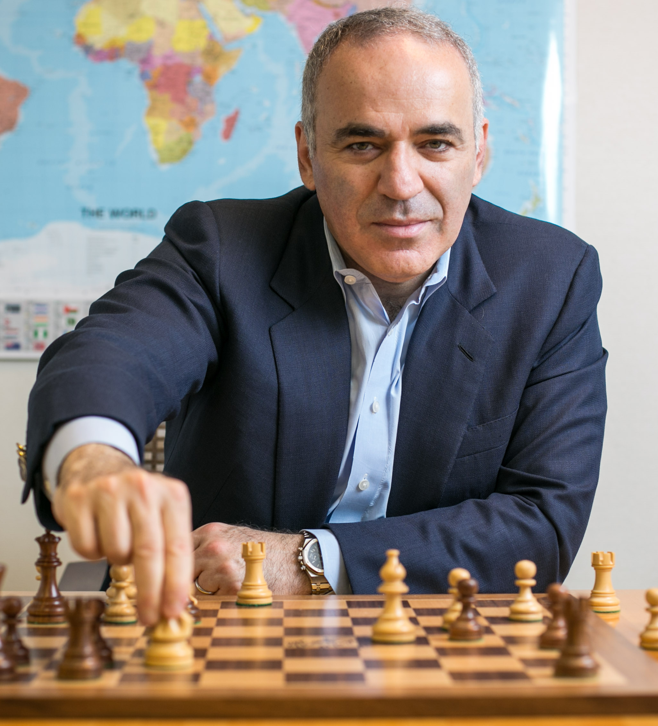
1996: Deep Blue
VS

Slide 3
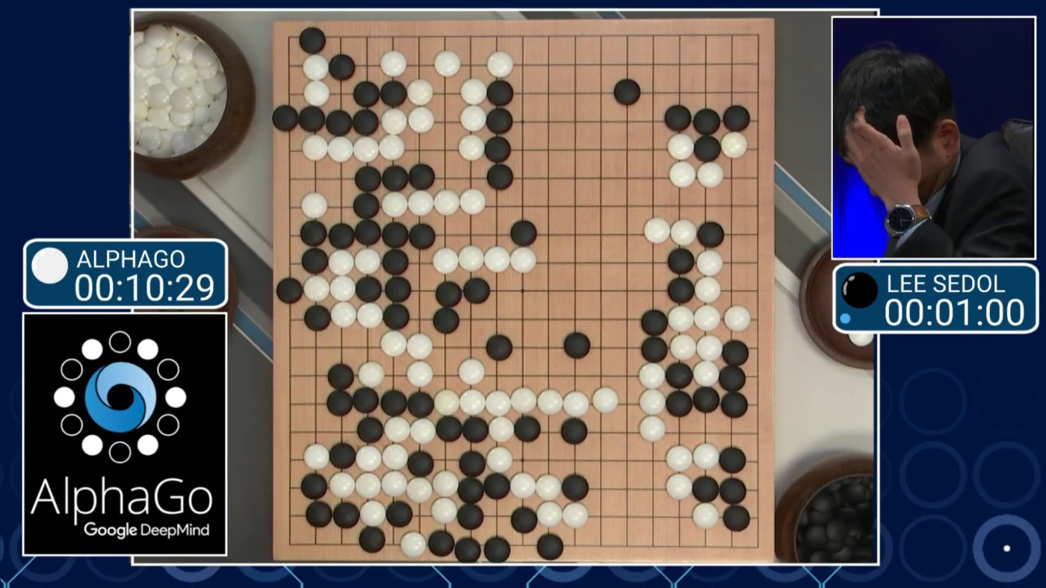
2016: AlphaGo
https://www.engadget.com/2016/03/12/watch-alphago-vs-lee-sedol-round-3-live-right-now/

Slide 4
Are these computers
smarter than humans?

Slide 5
Are these computers
INTELLIGENT?

Slide 6
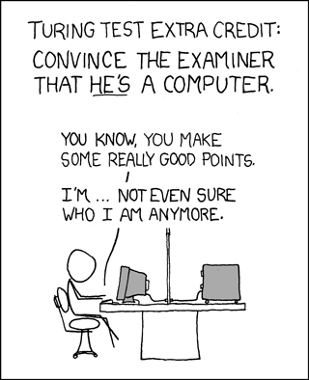
Turing test
Inventor: Alan Turing
Year: 1950
Test: Convince a human that it is chatting with another human instead of a computer
https://xkcd.com/329/

Slide 7
If a computer can
solve the Turing test,
is it truly intelligent?

Slide 8
If a computer can
solve the Turing test,
is it truly intelligent?
No.

Slide 9
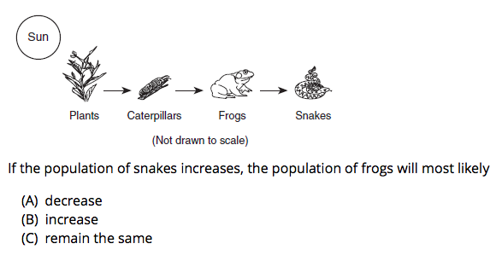
An example
http://aristo-demo.allenai.org

Slide 10
An example
Target: 4th grader
Goal: Interpreting a figure and world modelling
Problem: Not factoid questions and requires language understanding

Slide 11
New pillars
C O M M O N S E N S E
S
C
A
L
A
B
L
E
V A R I E T Y
C O M P L E X

Slide 12
Why 4th grade tests?
Measurable ✓
Graduated ✓
Not game-able ✓
Ambitious but realistic ✓
Motivating ✓

Slide 13



Tackling the problem
Artificial
Intelligence
Aristo

Slide 14
1. IMAGE RETRIEVAL
2. TEXT-BASED
KNOWLEDGE
EXTRACTION

Slide 15
PDFFigures2.0
Input: Scientific papers Step 1: Find the caption (keywords) Removing false positives (filters)
Step 2: Classify regions and text
Step 3: Assign captions with titles through clustering

Slide 16
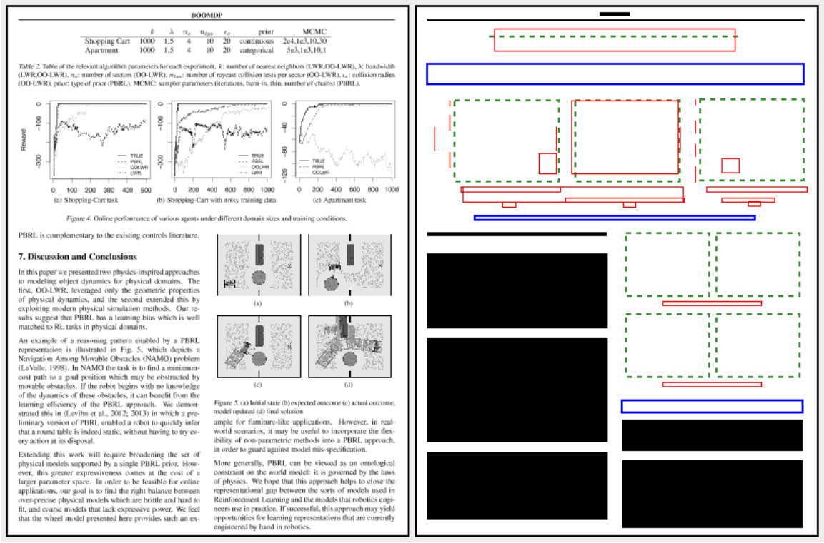
PDFFigures2.0 (Result)

Slide 17
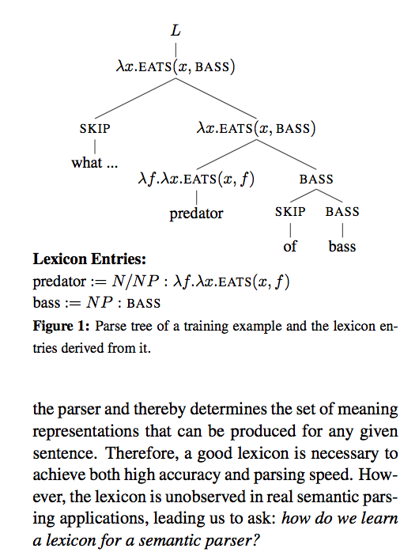
PDFFigures2.0

Slide 18
An example (Cont’d)
http://aristo-demo.allenai.org

Slide 19
Text-based knowledge extraction
Input: 4th grade text books Step 1: Match patterns with text to find relations between concepts
Step 2: Translate matched patterns (+ variants) to formal logic language
Step 3: Store knowledge as logical statements in knowledge base

Slide 20
Example
“Mechanical energy is produced when two objects move together.”
("two objects"/?x "produce" "Mechanical energy") "when“ /CONDITION
("two objects"/?x "move" "" [ "together" ])
forall m, t, o
isa(m,"move"), isa(t,"together"), isa(o,"two objects"), agent(m,o), arg(m,t)
-> exists p, e
isa(p,"produce"),isa(e,"Mechanical energy"), agent(p,o), object(p,e), condition(p,m).

Slide 21
Answering questions
1
2
What is the meaning
of the question?
What is the
correct answer?

Slide 22
1) What is the meaning of the question?
A question == A query for some piece of data
Goal: Construct a logical query that matches the question
One approach: Attempt to reconstruct the question from possibly logical queries

Slide 23
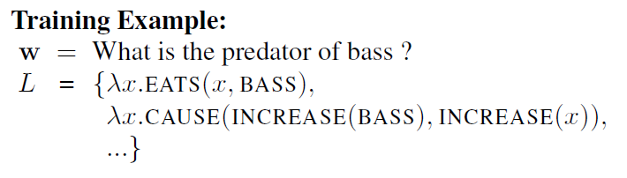
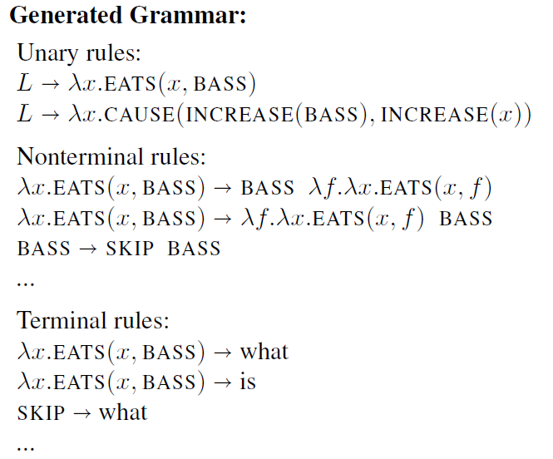
Training the model

Slide 24
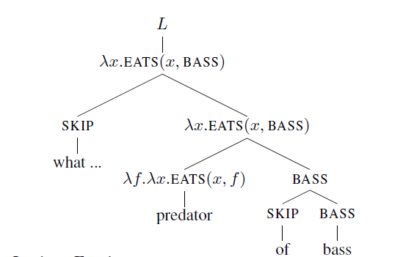
Applying the model

Slide 25
2) What is the correct answer?
Input: A multiple-choice question Step 1: Analyse the question and find important concepts
Step 2: Add background knowledge from knowledge base to form a graph
Step 3: Add option and prune graph
Step 4: Score option based on cohesion within knowledge graph

Slide 26
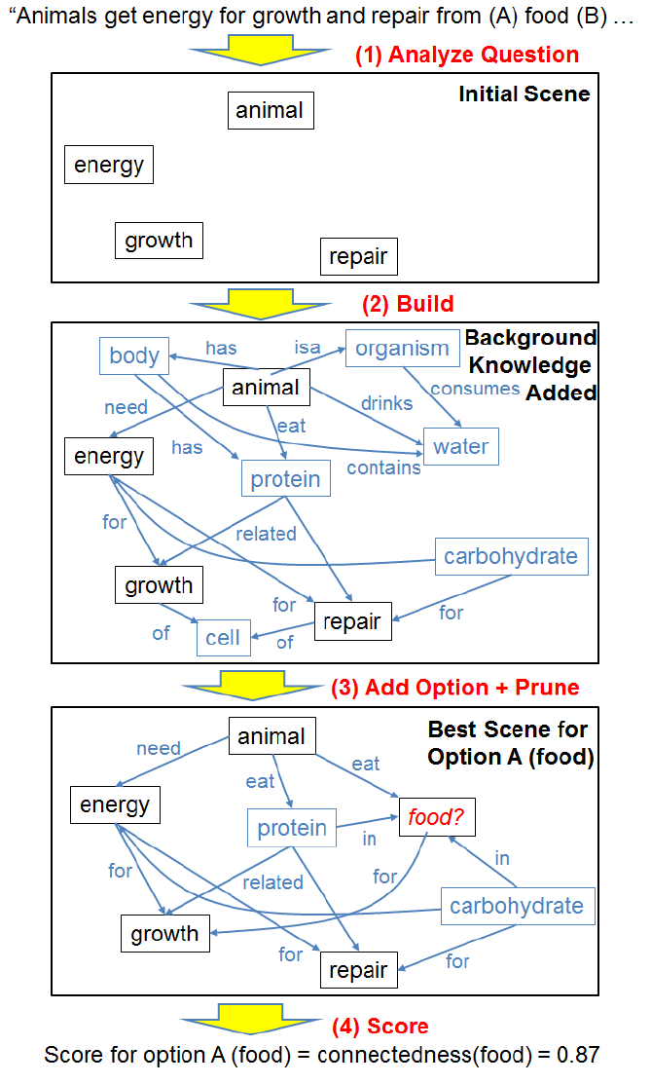

Slide 27
DEMO
http://aristo-demo.allenai.org

